Slide 1
Key Stage 1 SATS
Bathwick St Mary Primary School

Slide 2
Measuring Success
Children are assessed in reading, writing, mathematics, science, grammar, punctuation and spelling.
The emphasis is on teacher assessment
The children are continually assessed throughout the year
SAT tests are used to inform final teacher assessment.

Slide 3
Tests
Subject | Tasks and Tests for 2018
English | Reading test: combined reading prompt and booklet.
 | Reading Test: reading booklet and reading answer booklet.
Grammar, punctuation and spelling. | GPS: Spelling
 | GPS: questions
Maths | Mathematics: arithmetic
 | Mathematics: reasoning
There is no longer a written task/test to assess writing.

Slide 4
Levels
W | 1 | 2c | 2b | 2a | 3
There are NO LONGER levels for pupils.

Slide 5
What could your child’s assessment look like?
WT (working towards Age Related Expectation) | EXS (working AT the expected level) | GDS (working at GREATER DEPTH within the expected level)

Slide 6
How can you be sure we are levelling correctly?
The new National Curriculum has been delivered across schools since September 2014.
Within school we carry out internal moderation.
We also carry out external moderation alongside other schools.

Slide 7
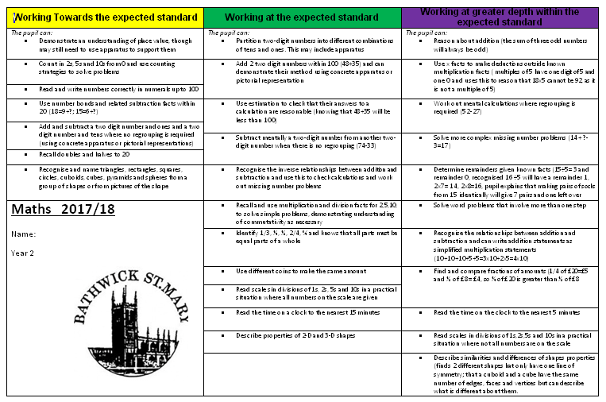
Assessment

Slide 8
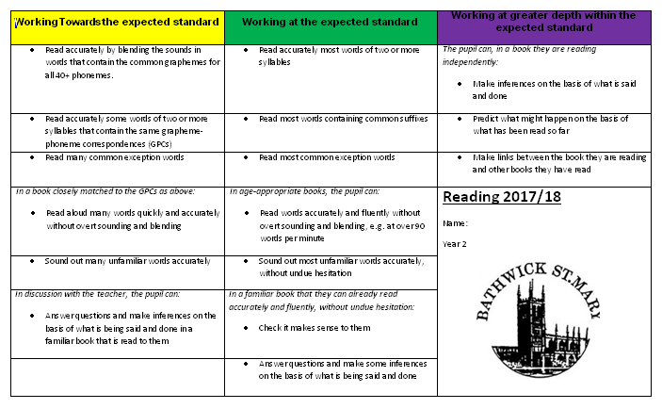

Slide 9
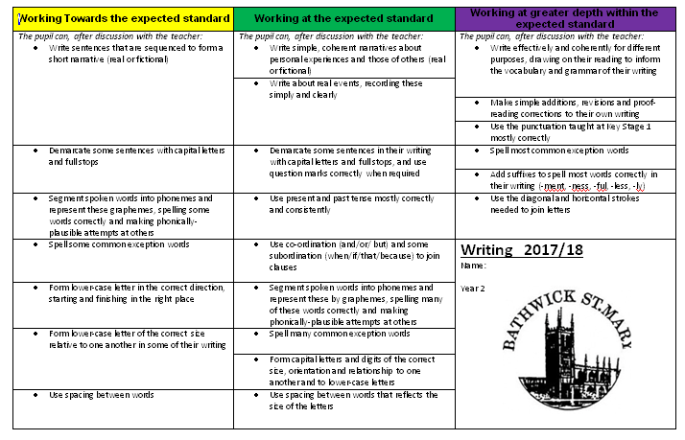

Slide 10
Reporting
Teacher assessments, not test results, are reported to the Local Authority
Teacher assessment levels are reported to parents. These will be included in your end of year report

Slide 11
What can you do at home?
Reading
Listen to your child read aloud.
Ask them to talk about particular words.
Get them to predict what might happen next.
Ask if they can think about any other story they may have read that is similar.

Slide 12
Writing
Ensure your child is using capital letters and full stops accurately.
Can they use a question mark?
Can they use capital letters for proper nouns.
Check spellings/using a dictionary
Can they re-read and edit their work!

Slide 13
Maths
Addition and subtraction (2 digits)
Multiplication and division (2,5,10, 3)
Fractions of a shape and quantity ( ½ , ¼, 2/4, 1/3, ¾)
Problem Solving/real life situations

Slide 14
Finally.........
Please don’t PANIC!
The tests will be administered as part of our daily routine.
Testing will start on Tuesday 8th May and the tests are spread out over two weeks.

Slide 15
Thank you for your time.

